Slide 1
LECTURE : 18B11CS311PML02
PROGRAMME : B.Tech.
COURSE TITLE : Computer Network and IoT
LECTURE TITLE : CIRCUIT SWITCHING AND PACKET SWITCHING , Physical Media
FACULTY NAME : Mr. Pankaj Mishra

Slide 2
CIRCUIT SWITCHING AND PACKET SWITCHING , Physical Media
By
Mr. Pankaj Mishra Dept. of CSE & IT JIIT, NOIDA

Slide 3
Topics of Today’s Lecture
Circuit Switching
Packet Switching
Physical Media

Slide 4





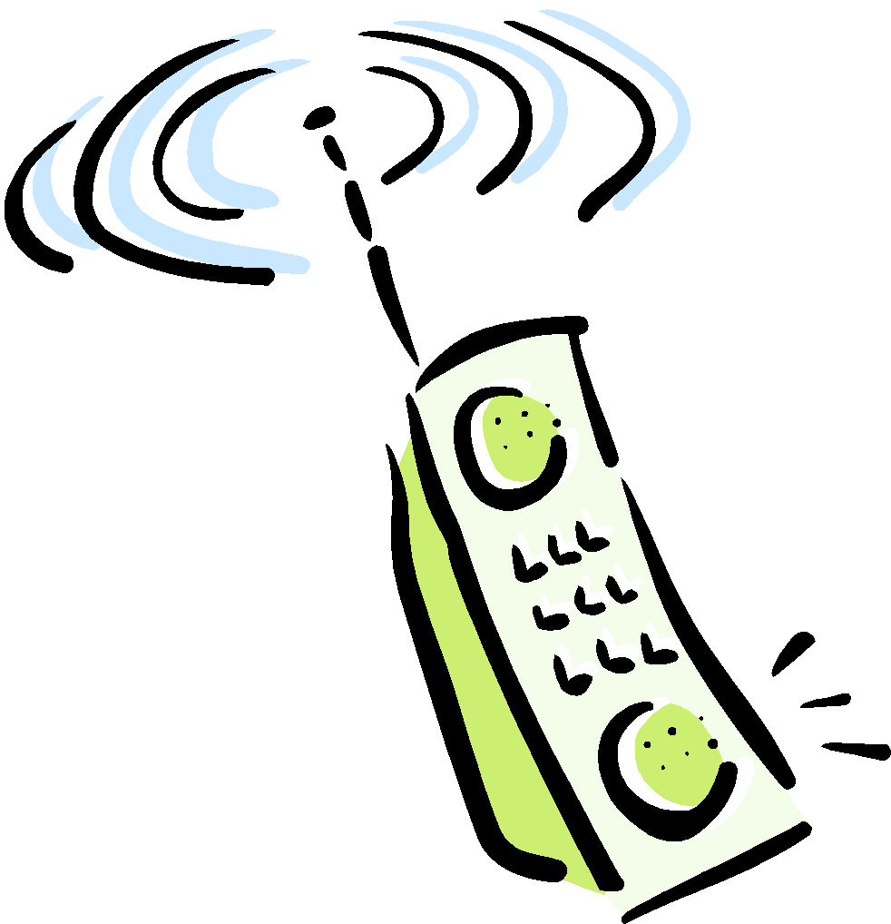

Circuit Switching
Circuit switching is a communication method where a dedicated communication path, or circuit, is established between two devices before data transmission begins. The circuit remains dedicated to the communication for the duration of the session, and no other devices can use it while the session is in progress. Circuit switching is commonly used in voice communication and some types of data communication.
Introduction
1-

Slide 5
Circuit Switching: FDM and TDM
Example:
FDM
4 users
frequency
time
TDM
frequency
time
Introduction
1-
Notes:
Two simple multiple access control techniques.
Each mobile’s share of the bandwidth is divided into portions for the uplink and the downlink. Also, possibly, out of band signaling.
As we will see, used in AMPS, GSM, IS-54/136

Slide 6
Numerical example
How long does it take to send a file of 640,000 bits from host A to host B over a circuit-switched network?
All links are 1.536 Mbps
Each link uses TDM with 24 slots/sec
500 msec to establish end-to-end circuit
Let’s work it out!
Introduction
1-

Slide 8
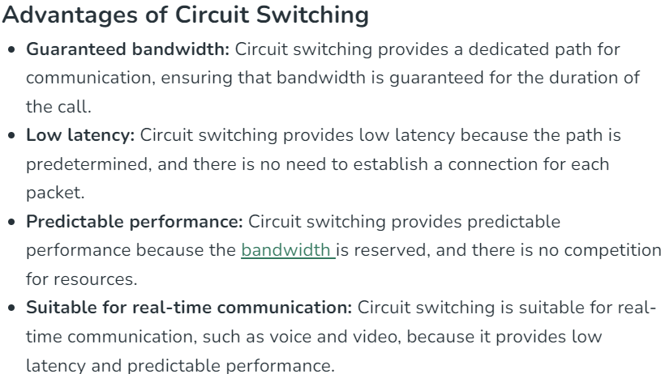

Slide 9
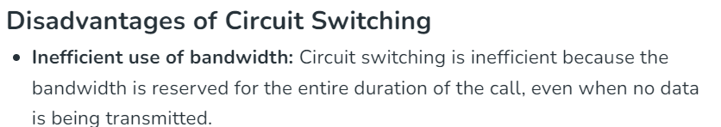


Slide 10
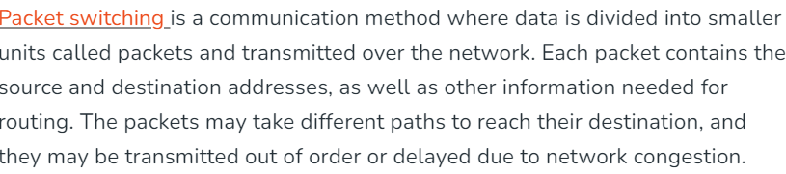
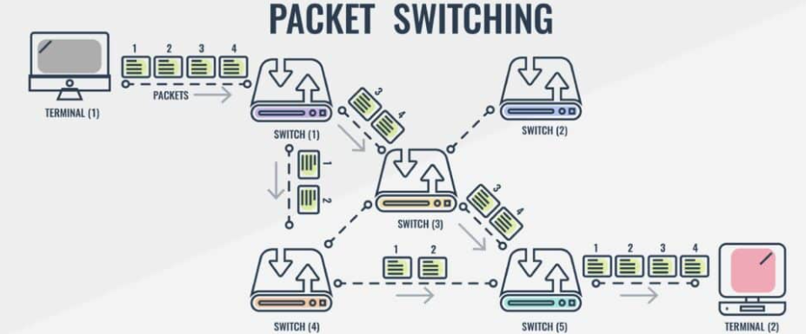
Packet Switching

Slide 11

store-and-forward
L
R
R
R
Takes L/R seconds to transmit (push out) packet of L bits on to link or R bps
Entire packet must arrive at router before it can be transmitted on next link: store and forward
delay = 3L/R (assuming zero propagation delay)
Example:
L = 7.5 Mbits
R = 1.5 Mbps
delay = 15 sec
more on delay shortly …
Introduction
1-

Slide 12
Physical Media
Twisted Pair (TP)
two insulated copper wires
Category 3: traditional phone wires, 10 Mbps Ethernet
Category 5: 100Mbps Ethernet
Bit: propagates between transmitter/rcvr pairs
physical link: what lies between transmitter & receiver
guided media:
signals propagate in solid media: copper, fiber, coax
unguided media:
signals propagate freely, e.g., radio
Introduction
1-

Slide 13


Physical Media: coax, fiber
Fiber optic cable:
glass fiber carrying light pulses, each pulse a bit
high-speed operation:
high-speed point-to-point transmission (e.g., 10’s-100’s Gps)
low error rate: repeaters spaced far apart ; immune to electromagnetic noise
Coaxial cable:
two concentric copper conductors
bidirectional
baseband:
single channel on cable
legacy Ethernet
broadband:
multiple channels on cable
HFC
Introduction
1-

Slide 14
Physical media: radio
signal carried in electromagnetic spectrum
no physical “wire”
bidirectional
propagation environment effects:
reflection
obstruction by objects
interference
Radio link types:
terrestrial microwave
e.g. up to 45 Mbps channels
LAN (e.g., Wifi)
11Mbps, 54 Mbps
wide-area (e.g., cellular)
e.g. 3G: hundreds of kbps
satellite
Kbps to 45Mbps channel (or multiple smaller channels)
270 msec end-end delay
geosynchronous versus low altitude
Introduction
1-

Slide 15
Thank You

